Slide 1

Penn Liberty Motors
Specialized Inventory

Slide 2
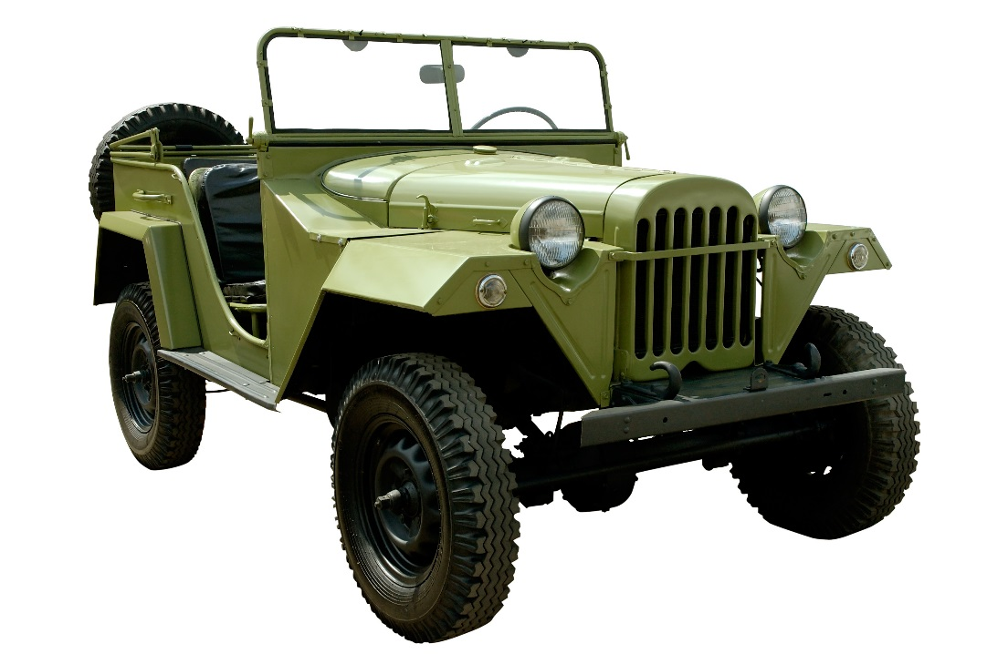
Rough Terrain Vehicles

Slide 3
Rough Terrain Vehicles Features
Comfortable
Rustproof
Non-corrosive
Maximum protection
Halogen headlights

Slide 4
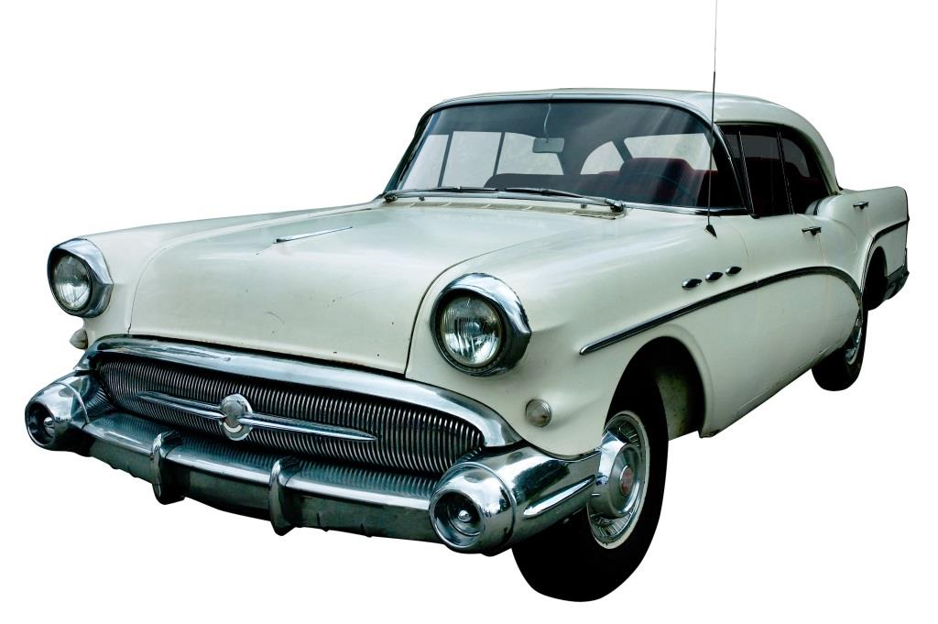
Classic Cars

Slide 5
Classic Car Features
Restoration Services
Only Authentic Parts
Warranty
Collections
Non-Salvaged Vehicles

Slide 6
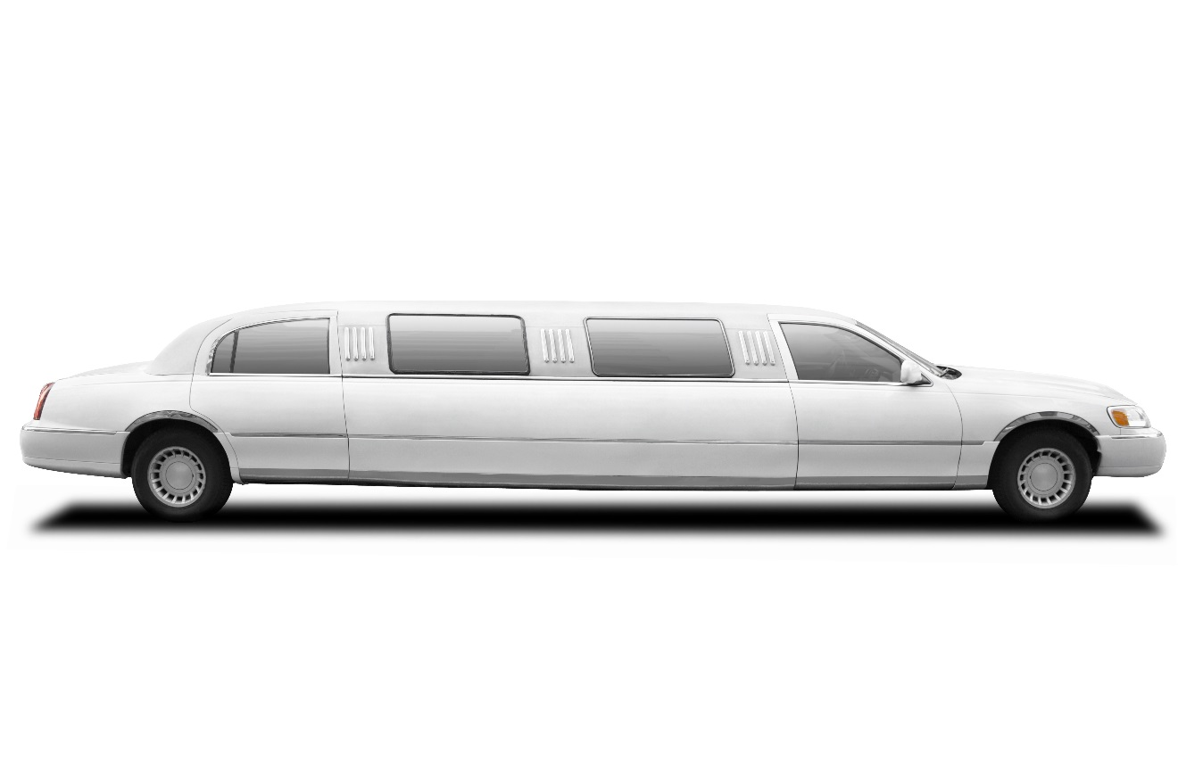
Limousines

Slide 7
Limousines Features
Divider Frame
Hands-Free Intercom
Bar with Foot Rail
Ice Compartment

Slide 8
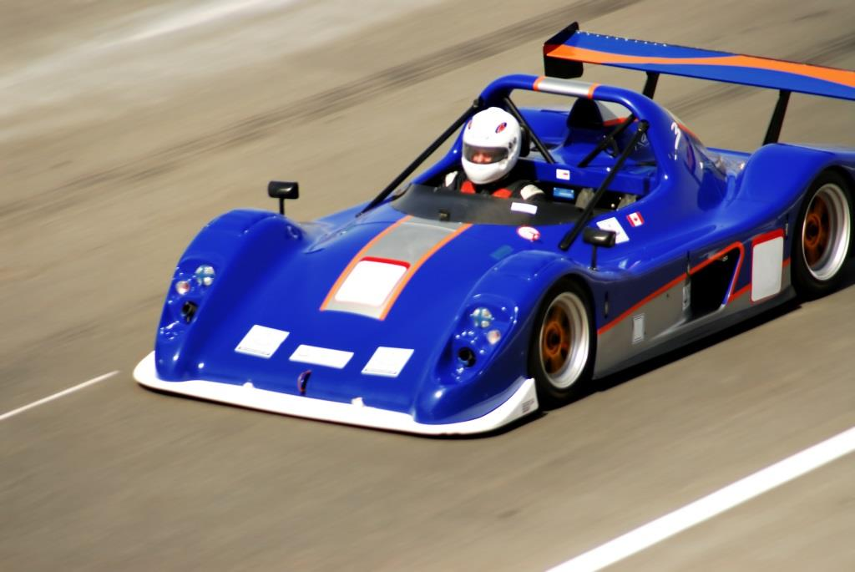
Race Cars

Slide 9

Race Car Features
High performance
Roof flaps
Restrictor plates
Five-point harness system
Head & neck restraints

Slide 10
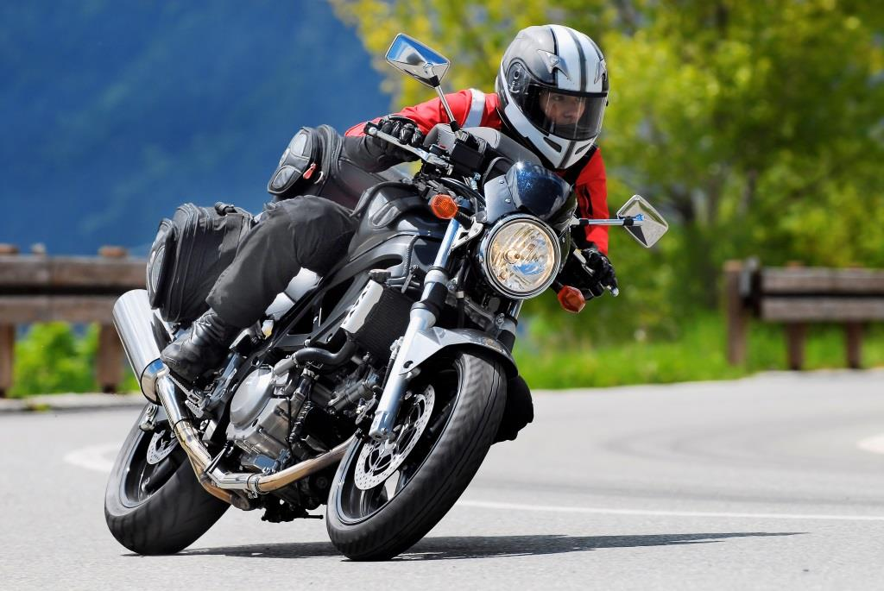
Motorcycles

Slide 11
Motorcycles Features
4-Cylinder Bikes
Cockpit Aerodynamics
Optimized Air Flow
Reduced Drag
Enhanced Rider Comfort

